Slide 1

JAVA : Topics
Java Features
Java Language Basics
Java Naming Rules and Conventions
Writing the code right way
Java Fundamentals
Variables:
Java Primitive Types &
Reference Types
String API
Date and Time API (including JDK8 API)
Arrays
1

Slide 2

Features of Java
Object-oriented
Abstraction, Encapsulation , Inheritance , Polymorphism
Simpler language
Compared to earlier OO languages like C++, it is simple
Designed considering the pitfalls of earlier languages
Robust
Automatic memory management and garbage collection is the biggest
contributor here. Strong type checking also helps.
Architecture Neutral / Portable
Java compiler generates an architecture-neutral object file format which makes the compiled code to be executable on many processors, with the presence of Java runtime system.
Secure : Built -in security features like absence of pointers and confinement of the java program within its runtime environment
Multithreading : Multithreading is the capability for a program to perform several
tasks simultaneously within a program
Distributed: Java is designed for the distributed environment of the internet.
2

Slide 3

Java Language Basics
Java API is a collection of packages.
A package is a collection of related classes and interfaces.
A Java application is a collection of one or more packages.
Java File extension is .java
Tester classes contain main() method:
main() method signature:
public static void main(String[] args)
Java Language is :
Case-sensitivity
Code Inside the Class Definition
3

Slide 4

Running on Different Platforms
Java is a platform independent language
“Write Once Run Anywhere”, popularly known as WORA
Source code (
x.java )
Java Program
Compiler
Converts source Code to
byte code ( x.class)
Interpreter
Interpreter
Interpreter
Converts byte code to machine code
Hello World
!
Hello World
!
Hello World
!
Win3 2
Solaris
MacOS

Slide 5

The Java Platform
Oracle provides two principal software products in the Java Platform, Standard Edition (Java SE) family:
Java SE Runtime Environment (JRE)
The JRE provides the libraries(packages), Java virtual machine, and other components necessary for you to run applications written in the Java programming language.
2.Java SE Development Kit (JDK)
The JDK includes the JRE plus command-line development tools such as compilers and debuggers that are necessary or useful for developing applets and applications.
5

Slide 6

Java Platform
Java Development Kit (JDK)
JDK consists of Java API, Java Compiler, and JVM
The Java Application Programming Interface (API)
The API is a large collection of ready-made software components that provide many useful
capabilities. It is grouped into libraries of related classes and interfaces; these libraries are known as packages.
The JVM is by definition a virtual machine, that is a software machine that simulates what a real machine does.
JDK
JRE
Java Complier
Like real machines it has an instruction
set (the bytecodes), a virtual computer architecture
and an execution model.
Java API
Java Virtual Machine
It is capable of running code written with this virtual instruction set, pretty much like a real machine can run machine code.
Hardware - Based Platform

Slide 7

Java Code Compilation and Execution
JVM
Source File (HelloWorld.java)
Class Loader
Byte Code Verifier
Compiler (javac) javac HelloWorld.java
Interpreter
JIT Code
Generator
Runtime
Machine Code or Byte code (HelloWorld.class)
java HelloWorld
Operating System
Hardware
In computing, just-in-time (JIT) compilation, also known as dynamic translation, is compilation done during execution of a program – at run time – rather than prior to execution.
Most often this consists of translation to machine code, which is then executed directly.

Slide 8

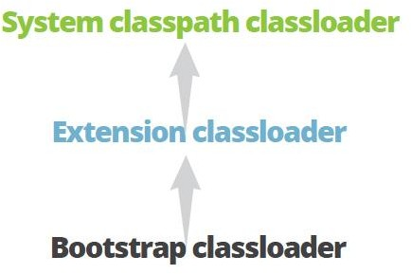
Class loader hierarchy
Whenever a new JVM is started the bootstrap class loader is responsible to load key Java classes (from java.lang package) and other runtime classes to the memory first. The bootstrap class loader is a parent of all other class loaders
Next comes the extension classloader. It has the bootstrap class loader as parent and is responsible for loading classes from all .jar files kept in the ../jre/lib/ext directory path–these are available regardless of the JVM’s classpath.
The third and most important class loader from a developer’s perspective is the system classpath class loader, which is an immediate child of the extension class loader.
It loads classes from directories and jar files specified by the CLASSPATH environment variable, java.class.path system property or -classpath command line option.
8

Slide 9

JAVA API
package
package
class class
class class
interfac e
interfac e
interfac
e
interfac
e
package
package
class class
class class
interfac e
interfa ce
interfac e
interface

Slide 10

Structure of a java program
[package packagename; ]
import packagename.classname;
……
public class ClassName [extends SuperClassName [ implements InterfaceName,… ] ]
{
instance variables (instance fields) class variables (static fields)
instance methods
class methods( static methods)
public static void main(String args[]){
……………….
}
optional
}

Slide 11

Java Sample Program
HelloWorld.java
//Hello World example.
public class HelloWorld{
Why public before class name?
public static void main(String args[]){ System.out.println("Hello World!");
}
}
What is public static void before main() method?

Slide 12

Keywords
The keywords/ reserved words defined in the Java language has
50 keywords and 3 literals (true, false & null).

Slide 13

Identifiers
Identifiers are the names of variables, methods, classes, packages and interfaces.
An identifier is a sequence of one or more characters.
Identifier is unlimited-length sequence of Unicode letters and digits, beginning with a letter, dollar sign "$", or underscore character "_".
Keywords cannot be declared as identifiers
Identifiers in Java are case-sensitive

Slide 14

Java Naming Conventions
Variable Names and Method Names
Ex. String title; int bookCode; String myFamilyDetails;
Types of variables: field Variables & local variables
About Local Variables
To be initialized before usage
Class/Interface Names
Ex. Book , AccountMaster, EmployeeContract
Built-in classes:
System, PrintStream , WindowListener , MouseMotionListener etc.
Package Names
Ex.
java.io.FileInputStream; java.util.Date;

Slide 15

Writing the code right way
The best practices are primarily targeted towards improvement in the readability and maintainability of code with keen attention to performance enhancements.
By employing such practices the application development team can demonstrate their proficiency, profound knowledge and professionalism.

Slide 16

Environment variables
Create system variable, JAVA_HOME which will be the Java Installation directory
System Properties -> Advanced -> Environment Variables -> Click on New button of System variables
Variable Name : JAVA_HOME
Variable Value : C:\Program Files (x86)\Java\jdk1.8.0_05 ( installation path of java)
Set the PATH variable : Path variable is used by OS to locate executable files.
In System Variables, select PATH and click on Edit button. Append the following :
%JAVA_HOME%\bin
This approach helps in managing multiple versions of Java – Changing JAVA_HOME will
reflect on CLASSPATH and PATH as well
Dot(.)
Set the CLASSPATH
Click New button of User Variable and enter: Variable name : CLASSPATH
Variable Value : %JAVA_HOME%\lib\tools.jar;.;
indicates current diectory

Slide 17

Variables
Two types of variables
Primitive type
Reference type
A variable is a place holder that can hold single value at a time.
Declaration of a variable:
datatype variableName [=value];

Slide 18

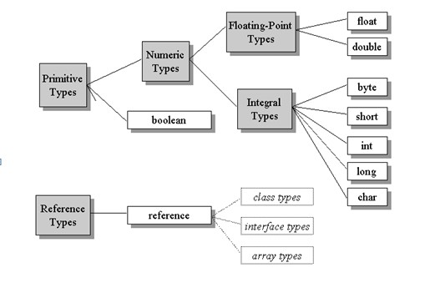
Data Types in Java

Slide 19

Primitive Data Types in Java
Integer data types
byte (1 byte)
Notes:
All numeric data types are signed
The size of data type remains the same on all
platforms (standardized)
char data type in Java is 2 bytes because it uses UNICODE character set.
Unicode is a industry standard designed to uniquely encode characters used in different human languages.
The other character sets are ASCII and EBCDIC character sets
short (2 bytes) -32768 to 32767
int (4 bytes)
long (8 bytes)
Floating Type
float (4 bytes)
Ex. float price = 25.67f;
double (8 bytes)
Ex. double salary = 2345.6556;
Textual
char (2 bytes) 65536
Declaration of a variable:
datatype variableName(s);
Ex. char operator = ‘+’ ;
Logical
boolean (1 bit (true/false)
Ex. boolean flag = true;
Ex.
int radius;
double area,circumference;
Note: datatype can be primitive type or reference type

Slide 20

Variables in Java
Java programming language defines the following types of variables
Data members/fields of a class:
o
o
instance Variables static/class Variables
Local variables : declared within a method
Method parameters/arguments : receive data and they are
local to the method

Slide 21

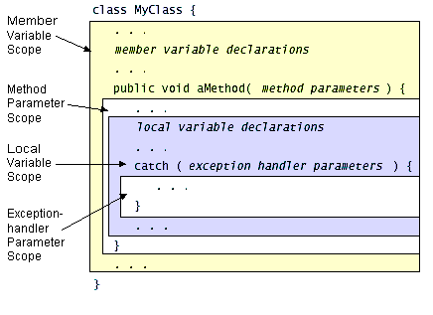
Variables in Java

Slide 22
JAVA FOP : Topics
Type casting
Command-line Arguments

Slide 23


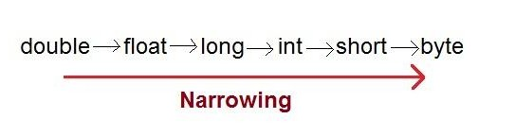
Type Casting
Java is a Strongly typed language
Unlike C, at runtime type checking is strictly enforced
In Java, type casting is classified into two types,
Widening Casting(Implicit)
Invalid Conversions
Any primitive type to any reference type
The null value to any primitive type
Any primitive to boolean
A boolean to any primitive
Narrowing Casting(Explicit)

Slide 24

Command-line Arguments
A Java application can accept any number of arguments from the command line.
This allows the user to specify configuration information when the application is launched.
When an application is launched, the runtime system passes the command- line arguments to the application's main method via an array of Strings.
public class SumOfDigits {
public static void main(String[] args) {
try{
double r1=Double.parseDouble(args[0]); double r2=Double.parseDouble(args[1]);
System.out.println((r1+r2));
}
catch(NumberFormatException nfe){
System.out.println("Invalid data");
}
}
}

Slide 25

Conditional Statements
Conditional Controls
if statement
if else statement
Nested if statement
To test for more than one condition for a true expression
if else if else ladder
Usage:
Multiple-choice: To select one out of many
To check for ranges
switch statement

Slide 26

Conditional Statements
Iterative Controls
Types
while loop
do while loop
for loop
Nested Loop
Break and continue statements in a loop
About Increment and decrement operators

Slide 27

Classes, Object, Scope
Introduction to classes and objects
Explain object scope
Java reference types
Object scope
Explanation using memory structures

Slide 28

Introduction to classes and objects
A class is a set of specifications that describes the characteristics
(state) and behavior(functionality) of an entity.
Entities are real-world objects which are distinguishable from other
objects and can be transformed into programming-world classes.
Ex. Account, Employee, Supplier, Student etc
Entity
Has
Does

Slide 29

Introduction to classes and objects
Default constructor
Creating an instance/object:
ClassName objectName = new ClassName();
Parameterized constructor
OR
ClassName objectName = new ClassName(<parameters>);
Note: object name also called as object reference is a reference variable
Note: Every instance/object of a class has separate memory allocated in the Heap.

Slide 30



Reference Types in Java
objects and arrays are accessed using reference variables in Java
A reference variable is similar to a pointer (stores memory address of an object) but Java does not allow pointer manipulation or pointer arithmetic
object name or object reference
String string = new String(“Hello World”);
Java Stack
XXX | Hea | p
Hello World
string
XXX

Slide 31

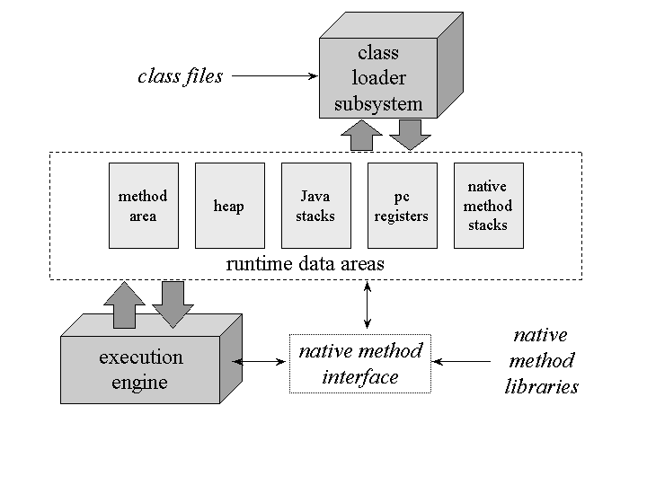
JVM Memory Structures
31

Slide 32

JAVA FOP : Topics
Arrays
Single-dimensional
find minimum, maximum, sum and average marks
Array manipulation:
Insert & delete
Passing arrays to methods
Methods returning Arrays
Implementation of stack and queue using arrays
Arrays class

Slide 33

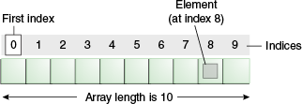
Arrays
An array is a container object that holds a fixed number of values of a single type.
The length of an array is established when the array is created. After creation, its length is fixed.
Each item in an array is called an element, and each element is accessed by its numerical index.
As shown above, indexing begins with 0.

Slide 34

Creating, Initializing, and Accessing an Array
I. Declaring array name:
Reference variable
datatype [ ] arrayName ;
or
datatype arrayName[]
Ex. int [ ] list; or int list[ ];
Allocating memory for holding data values
arrayName = new datatype[NE];
Ex. list = new int[10];
Combine I and II
datatype arrayName [ ] = new datatype[NE];
Ex. int list[] = new int[10];
Ex. String names[] = new String[10];
NE indicates Number of Elements( can be constant or variable)
Note : data type can be primitive type or reference type.

Slide 35
Traversing an array
It is convenient to use for each loop
The For-Each Loop : Can iterate through collection of objects
for(Type iterator-variable : iterableObject) { statement-block
}
Methods receiving & returning reference types.

Slide 36

Array Manipulation
Java SE provides several methods for performing array manipulations (common tasks, such as copying, sorting and searching arrays) in the java.util.Arrays class.
Commonly used methods of Arrays class:
static <T> List<T>asList(T... a) :Returns a fixed-size list backed by the specified array.
static int binarySearch(int[] a, int key) Searches the specified array of ints for the specified value using the binary search algorithm.
static char[] copyOfRange(char[] original, int from, int to) Copies the specified range of the specified array into a new array.
static int[] copyOfRange(int[] original, int from, int to) Copies the specified range of
the specified array into a new array.
static boolean equals(float[] a, float[] a2) Returns true if the two specified arrays of floats are equal to one another.
static void fill(double[] a, double val) Assigns the specified double value to each
element of the specified array of doubles.
static void sort(double[] a) Sorts the specified array into ascending numerical order.
static void sort(Object[] a) Sorts the specified array of objects into ascending order, according to the natural ordering of its elements.
Note: The above methods are overloaded to handle all types of arrays including Object type

Slide 37

2D Arrays
Declarations:
datatype [ ][ ] arrayName ; arrayName = new datatype[NR][NC];
OR
datatype arrayName [ ] [ ] = new datatype[NR][NC];
Note : NR- No. of Rows, NC-No. of columns(can be constant or variable). data type can be primitive type or reference type.
Ex.
Ex.
int m[][] = new int[4][3];
int [][] list = new int[4][ ];
list[0] = new int[3]; // First row has 3 columns list[1] = new int[4]; // Second row has 4 columns
Note: rows are allowed to vary in length hence called as jagged arrays.

Slide 38

2D Array Demo
class ArrayDemo {
public static void main(String[] args)
{
String[][] names = { {"Mr. ", "Mrs. ", "Ms. "},
{"Smith", "Jones"}
};
Mr.Jones
Ms.Smith
System.out.println(names[0][0] + names[1][1]); System.out.println(names[0][2] + names[1][0]);
}
}

Slide 39

2D Arrays in Java
Class Name: TwoDArrayDemo
Initialization :
int marks[][]= { {85,68,90} , {56,67,78,5},{98,89,85},{84,85} };
for(int i=0;i<4;i++){
System.out.println();
for(int j=0;j<marks[i].length;j++){ System.out.print(marks[i][j]+" ");
}
}
Returns number of columns in ith row
Note: When initializing 2D array, both the square brackets must be
empty.

Slide 40

String
String API
User-defined methods manipulating String objects.

Slide 41

String API
Java API has three classes to work on strings:
String
StringBuffer
StringBuilder

Slide 42

String class
String is a built-in class in Java. The fully qualified name of String class in Java is java.lang.String
Strings are immutable objects i.e. their values cannot be changed after they are created. Since String objects are immutable they can only be shared but not modified.

Slide 43

String Pool or Run time Constant Pool
String pool is a fixed block of memory within heap where the string objects are held by JVM.
If a string object is created directly , using assignment operator as
String s1 = “Hello”, then it is stored in String constant pool.
String s2 = “Hello” , then s1 == s2 will be true or false ?
true
System.out.println(s1.hashCode()); System.out.println(s2.hashCode());
Return same hashcode. Two equal
String objects return same hashcode
Method Area
Runtime constant pool
Java Stack
Heap
S1
S2
Hello
true
PC Registers
JVM Memory Structures

Slide 44

String objects
If a String object is created using new operator, then memory is
allocated in the heap.
String s1 = new String(“Hello”);
String s2 = new String(“Hello”);
System.out.println(s1.hashCode()); System.out.println(s2.hashCode());
Return same hashcode. Two equal
String objects return same hashcode
s1 == s2 will be true or false ?
false
Method Area
Run time constant pool
Java Stack
Heap
Hello
true
copyright 2016©Digitech Technologies
S1
PC Registers
S2
Hello
JVM Memory Structures

Slide 45

String objects
public static void main(String[] args) { String s1 = "Hello"; String s2 = "Hello"; System.out.println(s1==s2); System.out.println(s1.equals(s2));
String s3 = new String("Hello"); String s4 = new String("Hello"); System.out.println(s3==s4); System.out.println(s3.equals(s4)); System.out.println(s1.hashCode()+","+s2.hashCode()); System.out.println(s3.hashCode()+","+s4.hashCode());
}
String pool
Java Stack
Heap
Method Area
S1
Hello
Hello
S2
S3
PC Registers
Hello
S4
JVM Memory Structures
copyright 2016©Digitech Technologies

Slide 46
String objects
String s1 = "Hello"; System.out.println(s1);
s1 = s1+ "welcome";
System.out.println(s1)
If Strings are immutable, how do we justify these statements ?
Run time constant pool
Java Stack
S1
Hello
Hello Welcome
JVM Memory Structures

Slide 47
String Example
public class StringTest {
public static void main(String[] args) { foo("foo");
foo(new String("foo"));
foo("bar");
}
private static void foo(String string) {
if(string=="foo"){
string="1";
}else if(string.equals("foo")){ string="2";
}else if(string.equals("baR")){
string="3";
}else{
string="4";
}
System.out.println(string);
}
}

Slide 48

Common String class methods
char | charAt(int index) Returns the char value at the specified index.
boolean | contains(CharSequence s) Returns true if and only if this string contains the specified sequence of char values.
boolean | equals(Object anObject) Compares this string to the specified object.
boolean | equalsIgnoreCase(String anotherString) Compares this String to another String, ignoring case considerations.
int | indexOf(String str) Returns the index within this string of the first occurrence of the specified substring.
int | length() Returns the length of this string.
String | replace(char oldChar, char newChar) Returns a new string resulting from replacing all occurrences of oldChar in this string with newChar.
String[] | split(String regex) Splits this string around matches of the given regular expression.
String | substring(int beginIndex, int endIndex) Returns a new string that is a substring of this string.
boolean | matches() : Pattern matching

Slide 49

Regular expression
 | Subexpression | Matches
 | ^ | Matches beginning of line.
 | $ | Matches end of line.
 | . | Matches any single character except newline. Using m option allows it to match newline as well.
 | [...] | Matches any single character in brackets.
 | [^...] | Matches any single character not in brackets
 | \A | Beginning of entire string
 | \z | End of entire string
 | \Z | End of entire string except allowable final line terminator.
 | re* | Matches 0 or more occurrences of preceding expression.
 | re+ | Matches 1 or more of the previous thing
 | re? | Matches 0 or 1 occurrence of preceding expression.
 | re{ n} | Matches exactly n number of occurrences of preceding expression.
 | re{ n,} | Matches n or more occurrences of preceding expression.
 | re{ n, m} | Matches at least n and at most m occurrences of preceding expression.
 | a| b | Matches either a or b.
 | \w | Matches word characters.
 | \W | Matches nonword characters.
 | \s | Matches whitespace. Equivalent to [\t\n\r\f].
 | \S | Matches nonwhitespace.
 | \d | Matches digits. Equivalent to [0-9].
 | \D | Matches nondigits.
 | \A | Matches beginning of string.
 | \Z | Matches end of string. If a newline exists, it matches just before newline.
 | \z | Matches end of string.
copyright 2016©Digitech Technologies 49

Slide 50
StringBuffer class
A thread-safe, mutable sequence of characters. A string buffer is like a String, but can be modified.
StringBuffer objects are safe for use by multiple threads. This class methods are synchronized.
The principal operations on StringBuffer are
append , insert and delete methods, which are overloaded so as to accept data of any type.
Creating StringBuffer object:
StringBuffer customerName=new StringBuffer(“Ravi Kumar”);

Slide 51

StringBuilder class
StringBuilder class is a copy of StringBuffer class except that
StringBuilder class is not thread-safe.
Hence all the methods of StringBuffer class apply to StringBuilder class.
This class is designed to replace StringBuffer in place where the string buffer is used by a single thread (as is generally the case).
When to use what:
Use String if you require immutability
Use StringBuffer if you need mutable + thread-safety
Use StringBuilder if you require mutable + without thread-safety

Slide 52

Date and Time API

Slide 53

Date class
Date class represents a specific instant in time, with millisecond
precision. Constructors public Date()
Allocates a Date object and initializes it so that it represents the time at which it was allocated, measured to the nearest millisecond.
Ex.
Date today = new Date();
System.out.println(today); //Wed Sep 26 12:18:43 IST 2012
public Date(long date)
Allocates a Date object and initializes it to represent the specified number of milliseconds since the standard base time known as “the epoch", namely January 1, 1970, 00:00:00 GMT.
Parameter: date in long in milliseconds since January 1, 1970, 00:00:00
GMT

Slide 54

Common Date class methods
boolean after(Date when) Tests if this date is after the specified date
boolean before(Date when) Tests if this date is before the specified date
int compareTo(Date anotherDate) Compares two Dates for ordering
boolean equals(Object obj) Compares two dates for equality.
long getTime()
Returns the number of milliseconds since January 1, 1970 00:00:00 GMT represented by this Date object.

Slide 55

SimpleDateFormat class
Date Formatting using SimpleDateFormat:
SimpleDateFormat converts java.util.Date to String and vice-versa SimpleDateFormat is a concrete class for formatting and parsing dates in a locale-sensitive manner.
This class is placed in java.text package

Slide 56

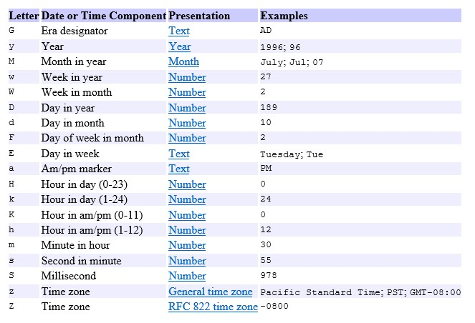
Date Formats

Slide 57

Date Formats
Input string Pattern
------- 2001.07.04 AD at 12:08:56 PDT
Wed, Jul 4, '01
12:08 PM
12 o'clock PM, Pacific Daylight Time
0:08 PM, PDT
02001.July.04 AD 12:08 PM Wed, 4 Jul 2001 12:08:56 -0700
010704120856-0700
2001-07-04T12:08:56.235-0700
2001-07-04T12:08:56.235-07:00
2001-W27-3
yyyy.MM.dd G 'at' HH:mm:ss z EEE, MMM d, ''yy
h:mm a
hh 'o''clock' a, zzzz
K:mm a, z
yyyyy.MMMM.dd GGG hh:mm aaa EEE, d MMM yyyy HH:mm:ss Z yMMddHHmmssZ
yyyy-MM-dd'T'HH:mm:ss.SSSZ yyyy-MM-dd'T'HH:mm:ss.SSSXXX
YYYY-'W'ww-u

Slide 58
Calendar Class
java.util.Calendar
The Calendar class is an abstract class that provides methods for converting between a specific instant in time and a set
of calendar fields such as
YEAR, MONTH, DAY_OF_MONTH, HOUR, and so on, and for
manipulating the calendar fields.
Calendar provides a class method, getInstance() which returns a Calendar object whose calendar fields have been initialized with the current date and time.

Slide 59
GregorianCalendar class
java.util.GregorianCalendar is a concrete subclass of Calendar and provides the standard calendar system used by most of the world, supports both the Julian and Gregorian calendar systems.
Constructor Summary
GregorianCalendar() Constructs a default GregorianCalendar using the current time in the default time zone with the default locale.
GregorianCalendar(int year, int month, int dayOfMonth) Constructs a GregorianCalendar with the given date set in the default time zone with the default locale.
GregorianCalendar(int year, int month, int dayOfMonth, int hourOfDay, int minute) Constructs a GregorianCalendar with the given date and time set for the default time zone with the default locale.
GregorianCalendar(int year, int month, int dayOfMonth, int hourOfDay, int minute, int second) Constructs a GregorianCalendar with the given date and time set for the default time zone with the default locale.

Slide 60
Thank You!

